Slide 1

Movie
Prophet
Statistical Programming
Team: Purrgramming
Names: Mao Yang, Jia Yu Pan, Rozanne Lim, Fan Yu

Slide 2

Key Challenge for Film Industry:
Unpredictable nature of a movie's success (box office)
Questions:
What are the underlying characteristics that transform a movie into a commercial
triumph?
Can we utilize these characteristics to predict success of a movie?
Targets:
Audience: Investors
Movies: Remakes and Originals
Motivation
Previous Work:
Zain Balfagih analyzed factors like budget, genre, actors, and directors, then built Random Forest and XGBoost models to predict profitability. (Balfagih, Z. IEEE 2024)
Beyond predicting if a movie will succeed, Gaurang Velingkar et al. used Random Forest model to specify the budget, runtime, and star power by expected box office input. (Velingkar, G, et al., IEEE, 2022)

Slide 3


Outline
Aim of the project
Create a comprehensive machine learning-based platform that not only predicts movie success but also prescribes optimal production strategies for targeted returns.
Data Processing
Data Analysis
Machine Learning Models
Dashboard Demo
Notes:
Limitations
Data limited to American films between 2000-2025
Additional restrictions on data due to missing values for box office revenue, and movie not found in the OMDB API database

Slide 4




Data collection
Data cleaning
Data analysis
Data dashboard
Flowchart
Notes:
We’ll discuss challenges, limitations, and our findings for each process

Slide 5


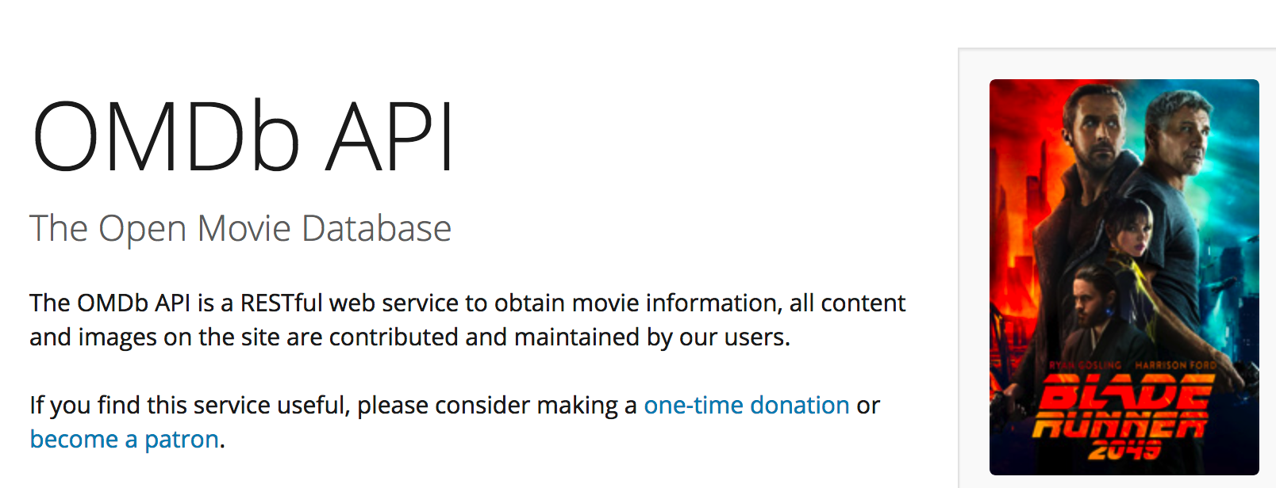
Data Sources
Challenges
Data Collection
Wikipedia - List of American Films released between the years 2000-2025 (November 16, 2025)
OMDB API - Parameters of interest such as genre, director, cast, IMDB ratings, Metascore, and box office revenue $$
PriceR package - inflation factors to convert box office revenue $ across the years
Finding publicly available data on box office revenues and working with limited APIs
APIs did not include a function to call for movies based on release year
API limit to 1000 calls/day
Notes:
I’ll start with some of the challenges we encountered with data collection and identifying data sources, since it informs our final data sources and procedure
One of the main challenges was finding publicly available data on box office revenues. We found online websites such as IMDB, and Box Office Mojo, however, these websites either had an exorbitantly priced API, or did not allow web scraping.
We found the OMDB API, which has information on all the parameters we were interested in including box office revenue data, and genre, cast, and runtime. Some kind person also created API wrappers for these databases, so we were able to easily get data from the database.
Our second challenge was that the APIs, although very useful, did not include functions to call for movies based on release year (2000-2024)
Our approach was to use rvest to scrape data from Wikipedia, which has different pages listing American films released by year, so we were able to use the title of the movies to call the API
Our third challenge was the API limit to 1000 calls/day; our initial sample was close to 7000 movies, so we split up the dataset into smaller subsamples
Finally, the third data source was the priceR package, which was used to get inflation factors to convert box office revenue across the years, so that we can compare the revenues over time
Our final sample ended up being around 4000 movies, this was due to movies not found in the OMDb database, or

Slide 6





Functional Programming Paradigm
Parameters of interest
Data Cleaning & Processing
Creating a function to scrape Wikipedia Lists of American Films released between the years 2000-2025
Using `purrr` package to create functions to call the OMDB API
Creating function to get inflation data
Genre (primary, secondary), box office revenue $, runtime, MPA film rating, date of release, director, actors, IMDB rating, Metascore
Notes:
For data cleaning and processing, we used many of the packages we discussed in the course, such as dplyr, forcats, lubridate and purrr, stringr.
The tidyverse packages were used to wrangle the data into the right format/type for ease of data analysis and visualization in the next steps.
I’ll speak a little more on the purrr package, to provide an example of how we used functional programming in our project.
Since the data on Wikipedia for american films released was in separate websites for each year, we created a function to scrape the data for each page, using the css selectors in rvest, and making use of the fact that the links had similar format
The map function was very useful in this situation
In addition, it was also used to create functions to call the OMDB API (we used the map_dfr to obtain a dataframe from each subsample)
A function was also created to get inflation data from the priceR package
Our final parameters of interest were: genre, box office revenue, runtime, MPA film rating, date of release, director, actors, IMDB rating, and Metascore

Slide 7


Challenges
Limitations
Data Analysis - Dashboard
Choice of visualization
Incorporating interactive elements
Formatting the dashboard
User-friendly and aesthetics
Data limited to American films between 2000-2025
Additional restrictions on data due to missing values for box office revenue, or movie was not found in the OMDB database
Notes:
Our final data product was a data dashboard, using flexdashboard and shiny R packages
Some of the challenges / that we thought was challenging was deciding on choice of visualization that would support our overall motivation for the project, and not just including graph for every single variable
We also learnt and incorporated interactive elements to make the dashboard more interesting, and using shiny elements
We also discussed the formatting of the dashboard, and making it user-friendly so that the audience is able to get the information they need from the dashboard.
Limitations
Limitations of our data dashboard is that data is from 2000-2024 / 2025
Additional restrictions on data due to missing values for box office revenue, or movie was not found in the OMDB database

Slide 8
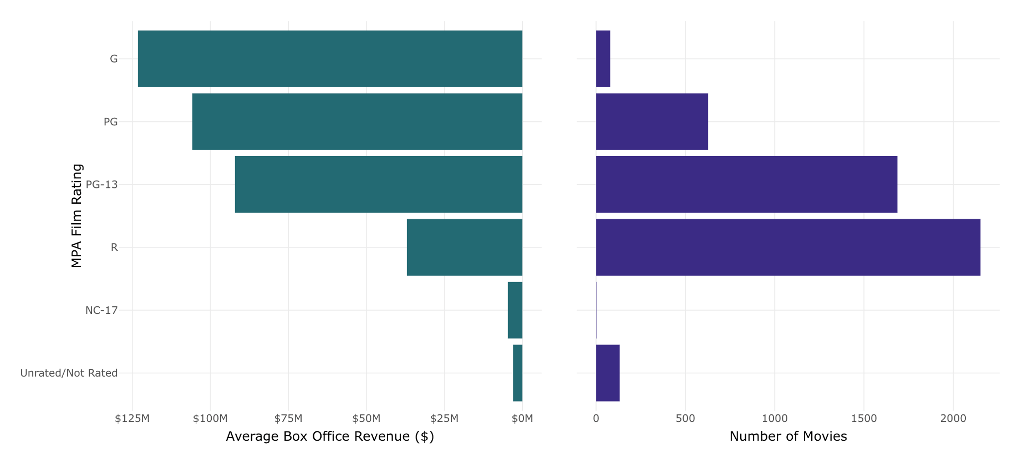
MPA Film Rating by Average Box Office Revenue ($) and number of movies
Notes:
We have the live demonstration coming up, but I’ll present three of the findings from our data analysis. One of our findings was that G rated movies have the highest average box office revenue over the 24 years, but not that many movies released are G rated. In contrast to that, R rated movies are the most common, but they do not yield as much in terms of revenue.
Findings
Top 3 movie genres by box office revenue: action, comedy and animation
Top 3 movie genres by number of movies: drama, action, comedy
R Rated Movies are the most common, but G rated movies have the highest box office revenue
Fantasy x Adventure movies have the highest box office revenue
Metacritic scores have increased over time
Box office revenues have decreased over time
R rated movies are the most common, but G rated movies have the highest box office revenue

Slide 9
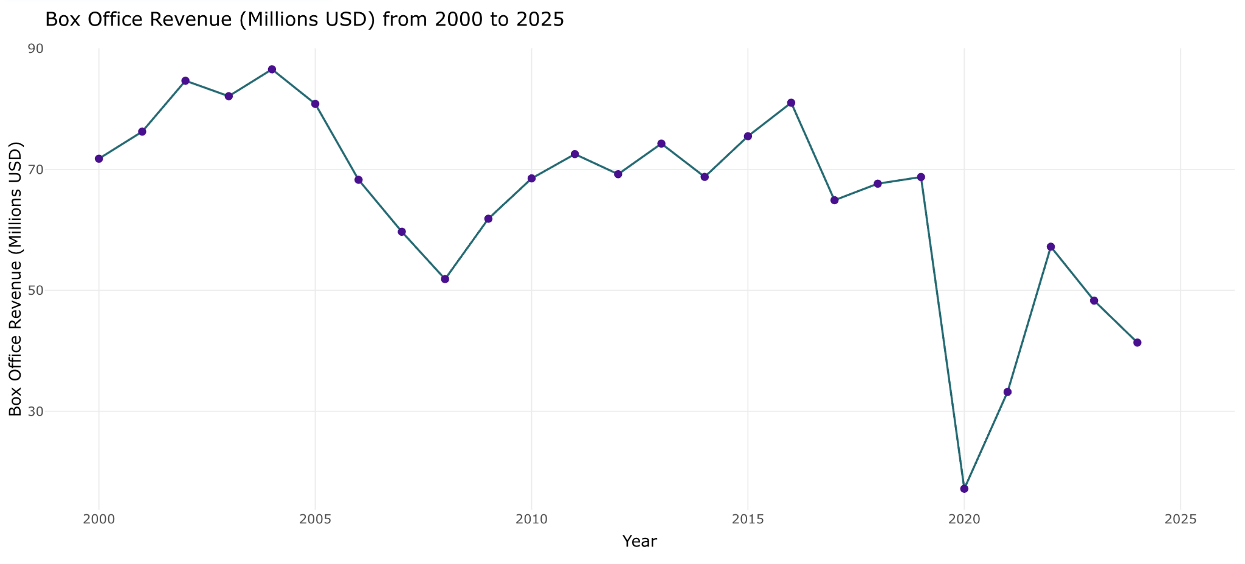
Notes:
Another finding is that box office revenues have decreased over time. Box office revenues measure traditional ticket sales in theatres and cinemas. This decrease is presumably attributed to introduction of streaming services, affecting ticket sales in cinemas. Note the low box office revenue in 2020!

Slide 10
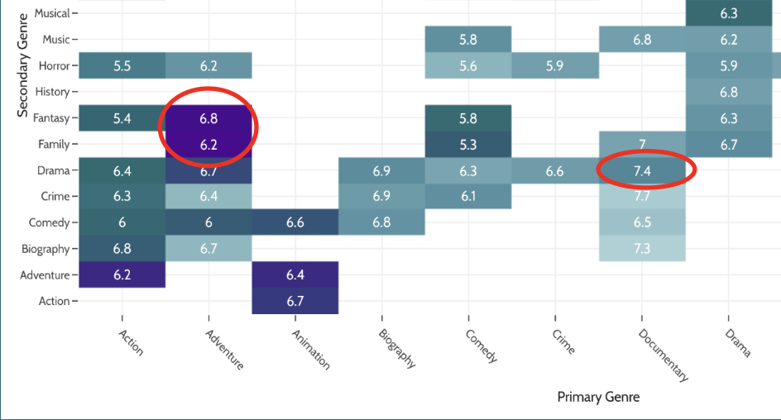
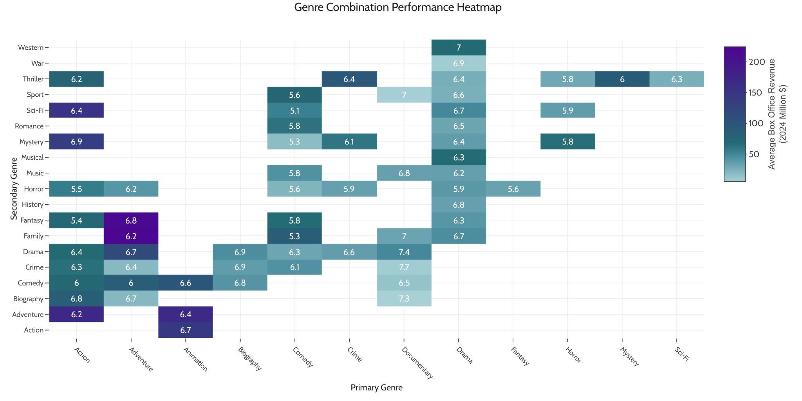
Notes:
Finally, we have a genre combination matrix, to see which combination of genres tend to have higher box office revenues. The x-axis is primary genre, and the y-axis is secondary genre. The legend shows the average IMDB rating for these genre combinations. So, Fantasy x Adventure or Adventure x Family movies have the highest box office revenue. On the other hand, Documentary x Drama movies seem to be highest IMDB rated combination.

Slide 11




Data Analysis - Machine Learning
Goal:
Predict box office based on movie attributes
Compare several ML models
Build up “What-if” simulation and AI recipe generator
Data preparation & feature engineering
Train multiple ML models
Evaluate using MSE & R²
Select best-performing model

Slide 12
Feature Engineering
🔢 Numeric transformations: rating², runtime²
📅 Time features: years_from_2000, summer, holiday
🎭 Genre encoding: Action, Drama, Sci-Fi, etc.
🔞 MPAA rating encoding：PG-13, R, PG
🎬 Movie length classification: long/short movie

Slide 13

Machine Learning Models
Random Forest
🔹 What it is
An ensemble model that combines many decision trees
Each tree learns different patterns; forest votes for final prediction
🔹 How it works
Uses bagging (bootstrap sampling)
Random feature selection at splits
Aggregates results: Prediction = average of all trees
Support Vector Machine (SVM)
🔹 What it is
A model that finds the best boundary (hyperplane) separating data
For regression, SVM fits a tube that minimizes errors beyond a margin
🔹 How it works
Maximizes the margin between data and prediction boundary
Can use kernels to model nonlinear relationships

Slide 14
Machine Learning Models
Generalized Additive Model (GAM)
🔹 What it is
A flexible regression model that allows non-linear relationships between features and target
Extends linear regression by adding smooth functions (splines)
🔹 How it works
Predicts outcome using: Y = β₀ + f₁(x₁) + f₂(x₂) + … + fₙ(xₙ)
Each f(x) is a smooth curve learned from data
Handles patterns that are non-linear and complex
Linear Regression
🔹 What it is
A simple baseline model that assumes a linear relationship between predictors and box office revenue
🔹 How it works
Fits a straight line that minimizes squared errors Y = β₀ + β₁X₁ + β₂X₂ + …

Slide 15
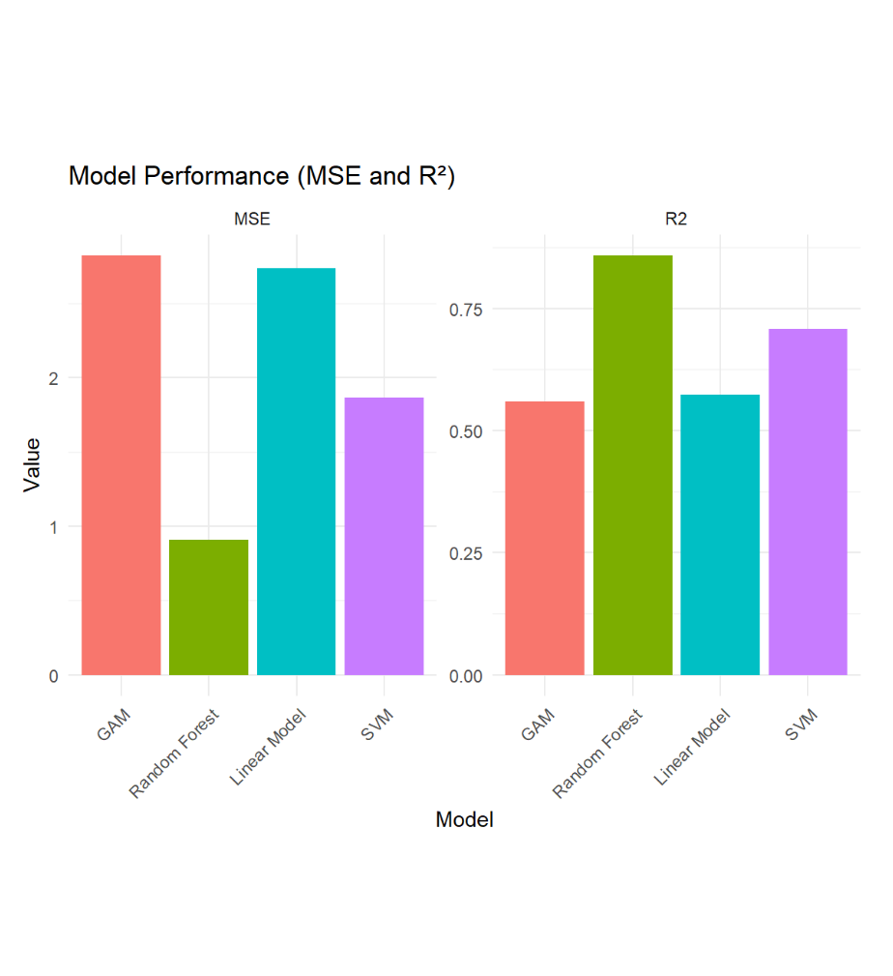
Performance Evaluation
Random Forest:
• Lowest MSE
• Highest R²
• Best performer
SVM:
• Better performer
GAM & LM:
• Higher error
• Lower R²

Slide 16
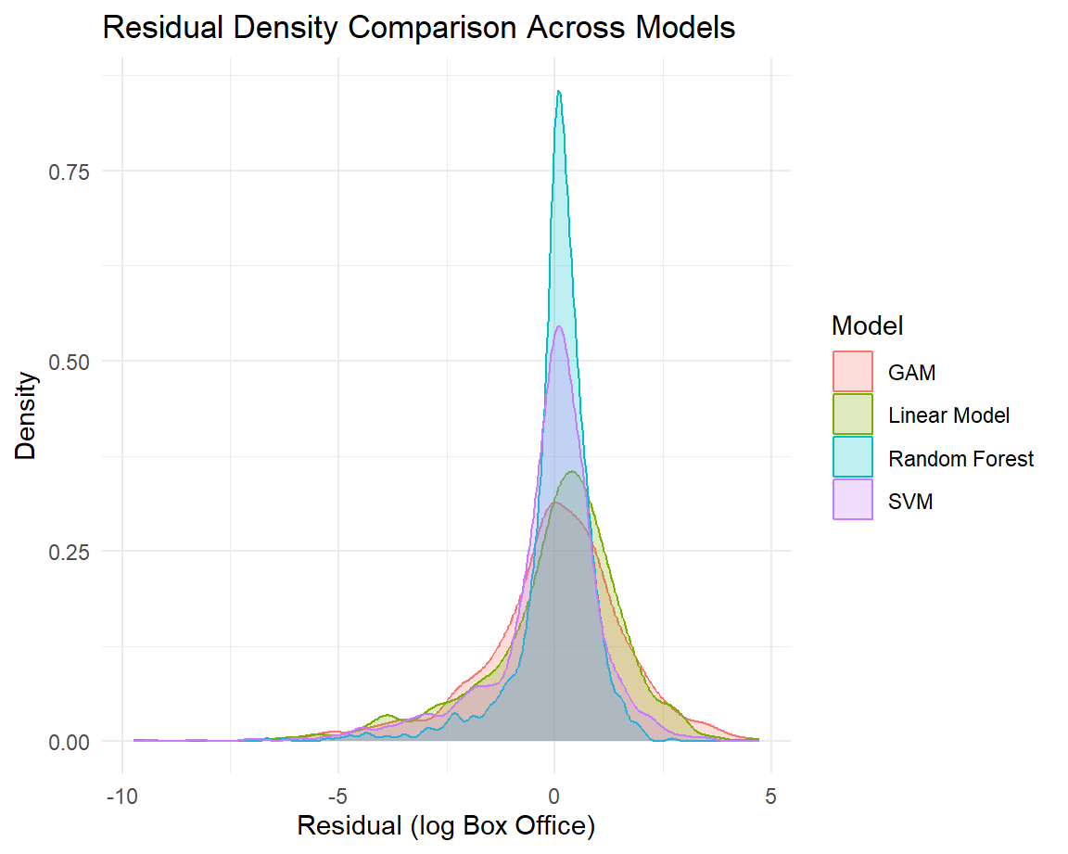
Performance Evaluation
Random Forest:
• Most concentrated residues

Slide 17
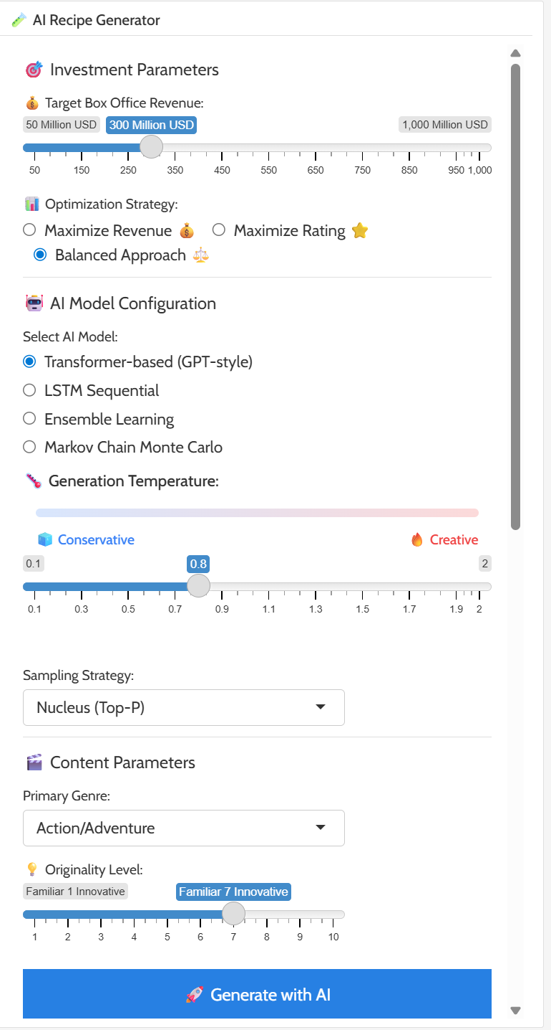
AI Generator Recipe
AI Recipe Generator — Core Idea
Uses text-generation AI models to recommend movie “recipes” based on investment goals, optimization strategy, and creativity settings.
Model selection:
Transformer-based (GPT-style) → best for creativity + coherent storyline suggestions
LSTM Sequential → smoother sequential patterns, more conservative
Ensemble Learning → blends multiple models for balanced output
Markov Chain Monte Carlo → simple statistical pattern generator
Generation temperature: Controls how creative or predictable the model behaves
Optimization Strategy: The selected strategy shapes how the model evaluates content trade-offs.(Revenue or Rating)
Sampling Strategy: Defines how the AI picks words or ideas
Content Parameter Constraints: User-selected constraints guide AI (genre and originality level

Slide 18
Challenge
What we learn
Machine Learning
Limited dataset size for ML models
High variance in movie box office
Risk of overfitting
Non-linear interactions hard to visualize
Handles non-linear relationships
Importance of Data Quality & Preprocessing
Value of Model Evaluation Techniques
Scenario Simulation & Model Integration

Slide 19
Dashboard Demo
Purrgramming

Slide 20
Thank you!
Questions?
Purrgramming

